Slide 1


Cong Cheng
2023-11-13

Slide 2

Outline
Executive Summary
Introduction
Methodology
Results
Conclusion
Appendix

Slide 3
Executive Summary
Summary of Methodologies
Data Collection
Webscraping
Data Wrangling
Exploratory Data Analysis(EDA)
Geospatial Analysis
Dashboard
Machine Learning Prediction
Summary of all results
After applying 4 different methods of machine learning, the results on the test set are almost the same among these 4 method. Further study is need for accuracy improvment.

Slide 4
Introduction
Project background and context
SpaceX has pioneered the technology with its Falcon 9 rocket. The ability for the first stage of a rocket to land is a significant advancement in aerospace technology, primarily because it represents a leap towards reusable launch vehicles, which can drastically reduce the cost of access to space.
Problems you want to find answers
Predict the success rate of first stage landing.

Slide 5

Section 1

Slide 6
Methodology
Executive Summary
Data collection methodology:
Request rocket launch data from SpaceX API
Webscrap from the Wikipage
Perform data wrangling
Define what bad outcomes are and create a new column “Class” to store the result
Perform exploratory data analysis (EDA) using visualization and SQL
Perform interactive visual analytics using Folium and Plotly Dash
Perform predictive analysis using classification models
Pre-processing
Split the data
Apply models
Tune hyperparameters with GridSearchCV

Slide 7
Data Collection
Request rocket launch data from SpaceX API
Webscrap from the Wikipage

Slide 8
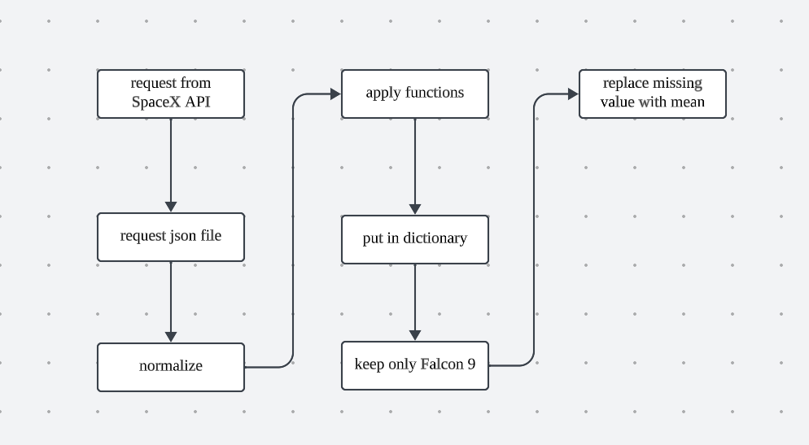
Data Collection – SpaceX API
Make request from SpaceX API with url.
Define functions to get corresponse data
Filter the data of interest and replace the missing value with mean value
GitHub URL:https://github.com/Csquaree/applied-data-science-capstone/blob/main/jupyter-labs-spacex-data-collection-api.ipynb

Slide 9
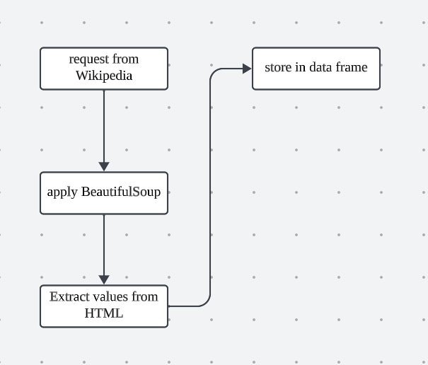
Data Collection - Scraping
Extract a Falcon 9 launch records HTML table from Wikipedia
Parse the table and convert it into a Pandas data frame
GitHub URL: https://github.com/Csquaree/applied-data-science-capstone/blob/main/jupyter-labs-webscraping.ipynb

Slide 10
Data Wrangling
Determine Training Labels:
Define what bad outcomes are
create a new column “Class” to store the result
GitHub URL:https://github.com/Csquaree/applied-data-science-capstone/blob/main/labs-jupyter-spacex-Data%20wrangling.ipynb

Slide 11
EDA with Data Visualization
Scatter plot (observe relationship)
Flight Number v.s. Launch Site
Payload Mass v.s. Launch Site
Orbit Type v.s. Flight Number
Payload v.s. Orbit Type
Bar chart (comparision)
Success rate v.s. Orbit Type
Line chart (understand the change)
Success rate v.s. Year
GitHub URL:https://github.com/Csquaree/applied-data-science-capstone/blob/main/jupyter-labs-eda-dataviz.ipynb.jupyterlite.ipynb

Slide 12
EDA with SQL
The SQL queries performed:
Display the names of the unique launch sites in the space mission
Display 5 records where launch sites begin with the string 'CCA'
Display the total payload mass carried by boosters launched by NASA (CRS)
Display average payload mass carried by booster version F9 v1.1
List the date when the first succesful landing outcome in ground pad was acheived.
List the names of the boosters which have success in drone ship and have payload mass greater than 4000 but less than 6000
List the total number of successful and failure mission outcomes
List the names of the booster_versions which have carried the maximum payload mass. Use a subquery
List the records which will display the month names, failure landing_outcomes in drone ship ,booster versions, launch_site for the months in year 2015
Rank the count of landing outcomes (such as Failure (drone ship) or Success (ground pad)) between the date 2010-06-04 and 2017-03-20, in descending order.
GitHub URL: https://github.com/Csquaree/applied-data-science-capstone/blob/main/jupyter-labs-eda-sql-coursera_sqllite.ipynb

Slide 13
Build an Interactive Map with Folium
what map objects are created and added to a folium map:
Mark all launch sites on a map
Mark the success/failed launches for each site on the map
Calculate the distances between a launch site to its proximities
The reason why these objects are added:
To help understand why they are here
GitHub URL: https://github.com/Csquaree/applied-data-science-capstone/blob/main/lab_jupyter_launch_site_location.jupyterlite.ipynb

Slide 14
Build a Dashboard with Plotly Dash
Pie chart
All Sites: to see the proportion of success rate in all locations.
Certain Site: to see the success rate in the certain site.
Scatter chart (with adjustable Payload Mass)
relationship between these two variables
GitHub URL: https://github.com/Csquaree/applied-data-science-capstone/blob/main/spacex_dash_app.py

Slide 15
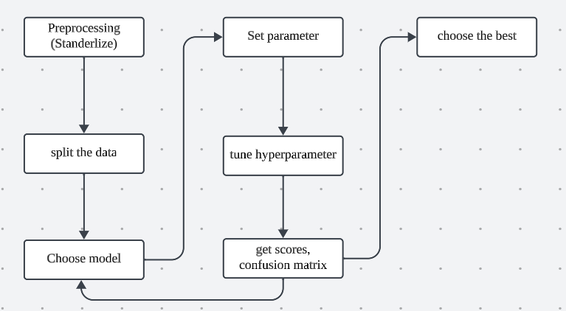
Predictive Analysis (Classification)
GitHub URL: https://github.com/Csquaree/applied-data-science-capstone/blob/main/SpaceX_Machine_Learning_Prediction_Part_5.jupyterlite.ipynb

Slide 16
Results
Exploratory data analysis results
Interactive analytics demo in screenshots
Predictive analysis results

Slide 17

Section 2

Slide 18
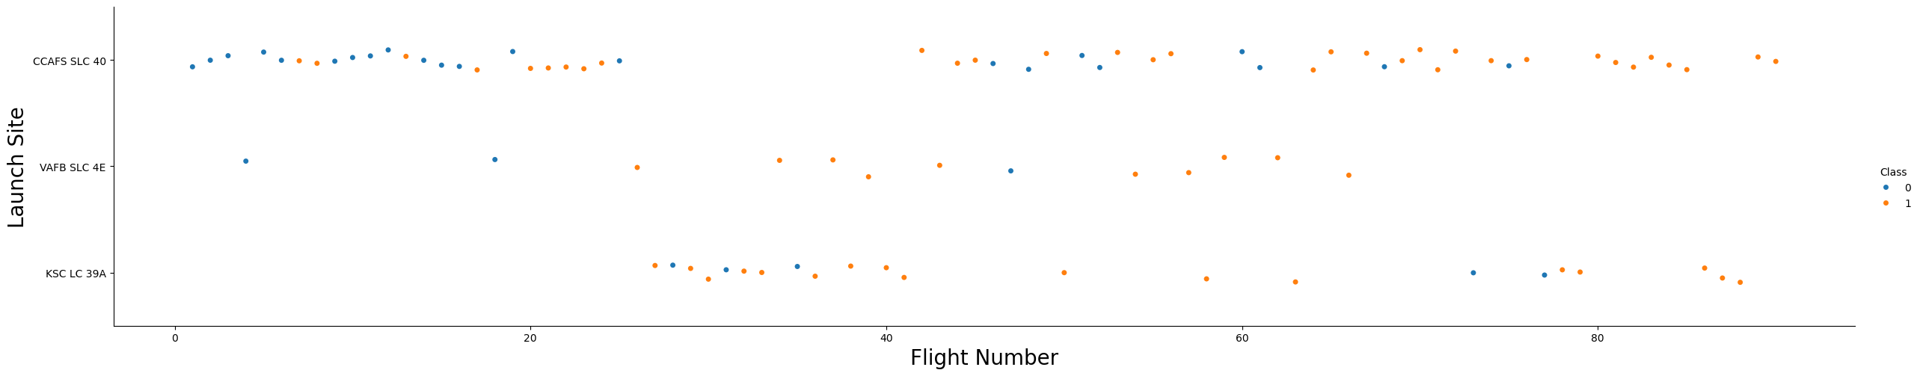
Flight Number vs. Launch Site
Show a scatter plot of Flight Number vs. Launch Site
Class 0 indicate failure, Class 1 indicate success.
After Flight Number 20, the count of success land becomes majority. CCAFS SLC 40 launched most flights from 1 to 25 and from 40 to 80+. VAFB SLC 4E launched the least flights. KSC LC 39A launched most flights from 25 to 40.

Slide 19
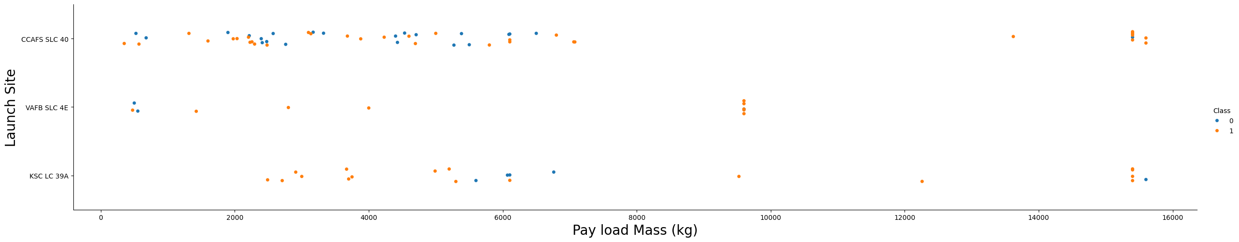
Payload vs. Launch Site
When the Payload Mass is haveier than 8000kg, only a few flights fail to land.
Most failure cases are have Payload Mass between 0 to 8000kg in CCAFS SLC 40

Slide 20
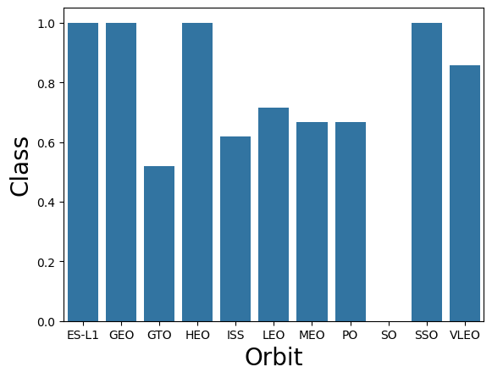
Success Rate vs. Orbit Type
ES-L1, GEO, HEO, SSO have 100% success rate.
SO has 0% success rate
VLEO has about 90% success rate
The rest orbit types have around 50%-70% success rate

Slide 21
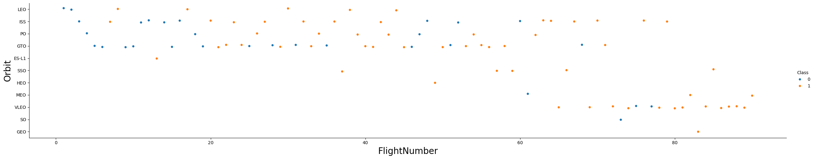
Flight Number vs. Orbit Type
Show a scatter point of Flight number vs. Orbit type
S
Most blue points are located in the left side of the plot indicating the successful rate is related to the flight number.
One thing about those have 100% success rate is that they all only have a small number of flights.

Slide 22
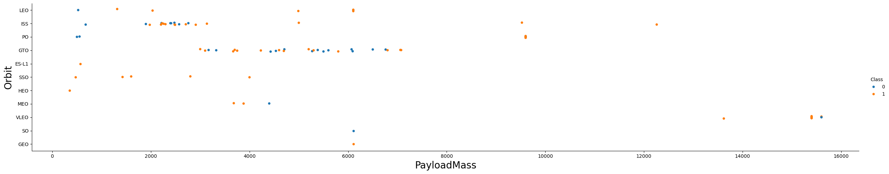
Payload vs. Orbit Type
Show a scatter point of payload vs. orbit type
Show the screenshot of
The relationship between mass and successful rate is not clear for ISS and GTO, and the rest of orbit types are have a few number of flights which is not enough to support any conclusions.

Slide 23
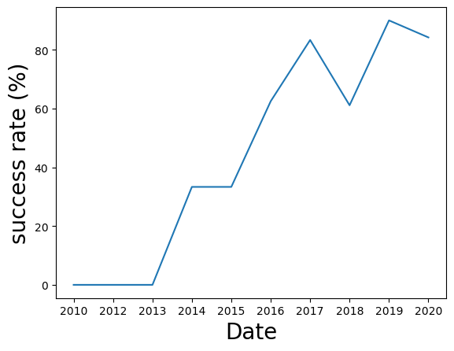
Launch Success Yearly Trend
The success rate is 0% from 2010 to 2013
The success rate is increasing over the time.
There is a significant decrease from 2017 to 2018.

Slide 24
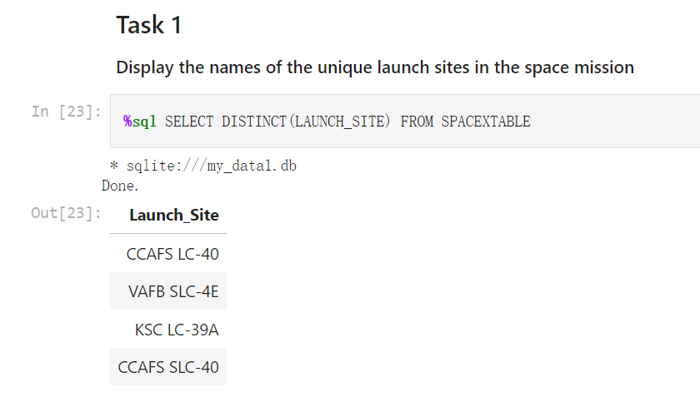
All Launch Site Names
Use Distinct to avoid repeated values

Slide 25
Launch Site Names Begin with 'CCA'
Find 5 records where launch sites begin with `CCA`
Present your query result with a short explanation here

Slide 26
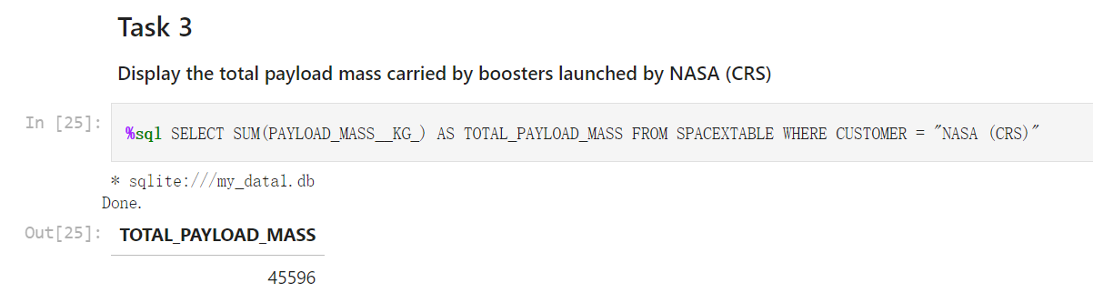
Total Payload Mass
Use ‘sum’ to add the value up and ‘as’ to assign a new name

Slide 27
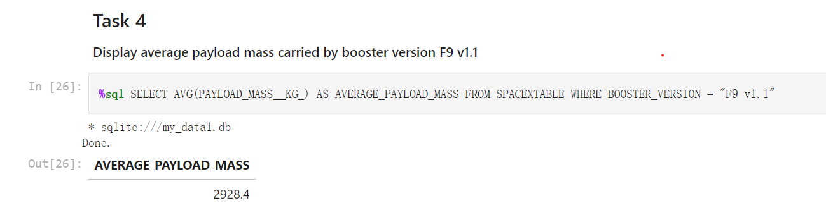
Average Payload Mass by F9 v1.1
Use ‘avg’ to find the mean

Slide 28
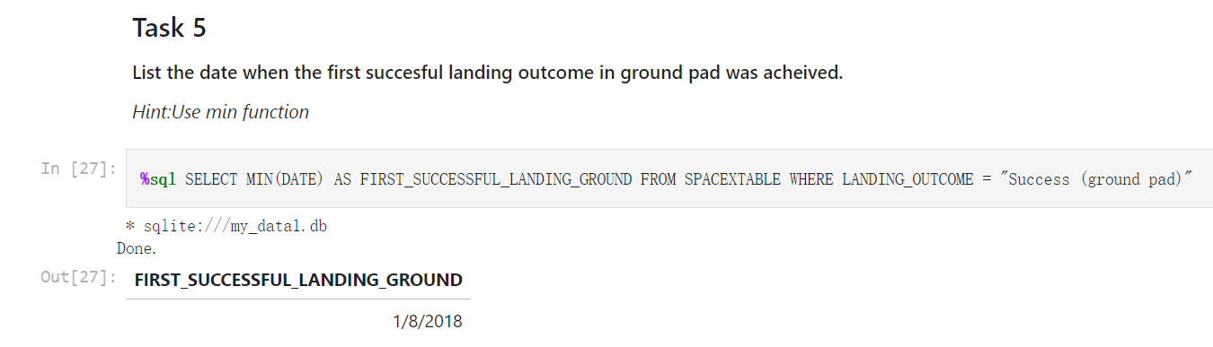
First Successful Ground Landing Date
Use ‘min’ to find the smallest value

Slide 29
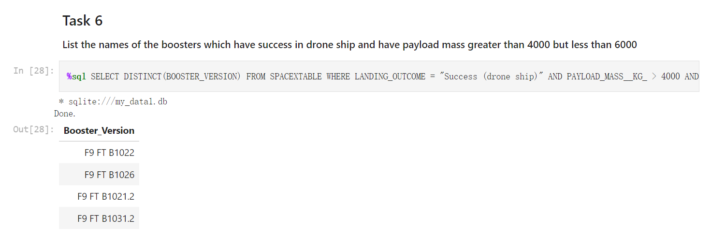
Successful Drone Ship Landing with Payload between 4000 and 6000
Use ‘Where’ to filter values

Slide 30
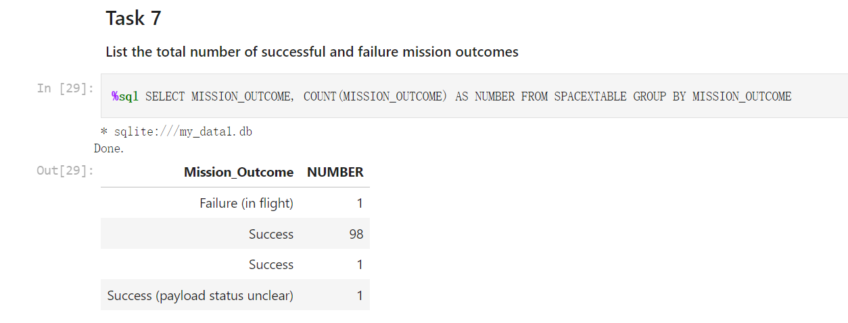
Total Number of Successful and Failure Mission Outcomes
Use ‘Count’ to find the number of a certain mission outcome
Use ‘Group by’ to group the rows with the same mission outcome up

Slide 31
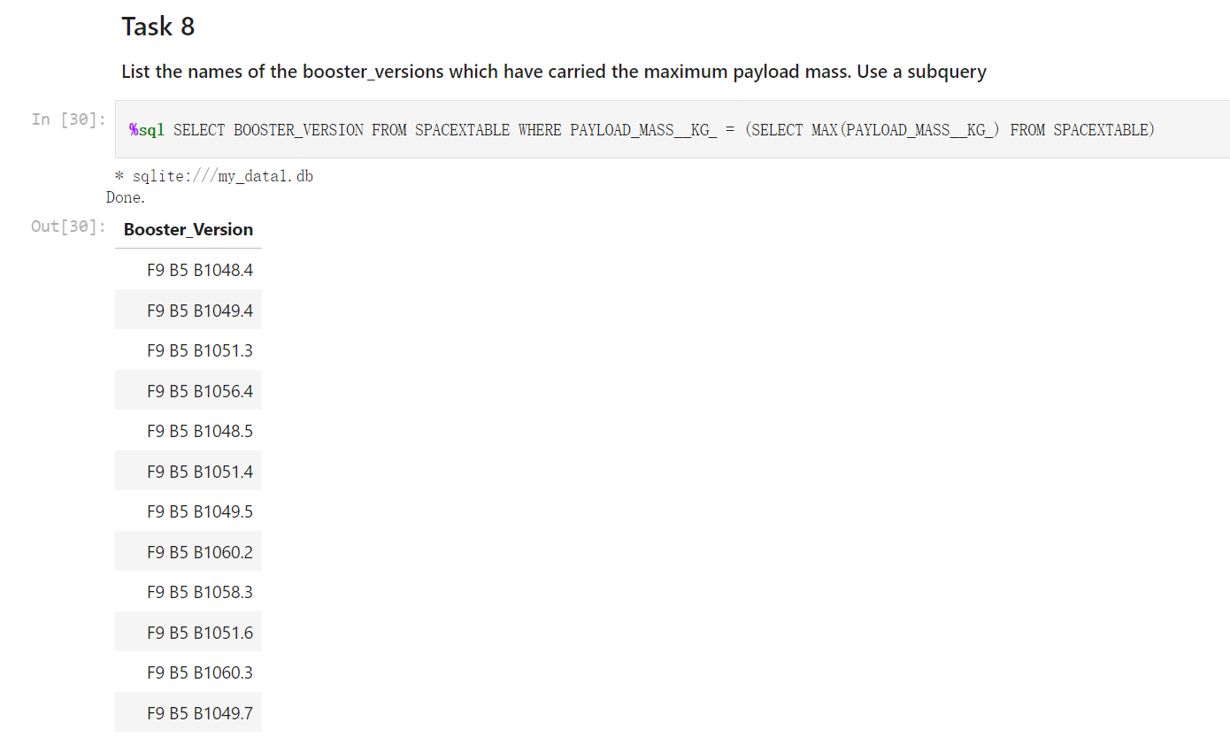
Boosters Carried Maximum Payload
Use subquery to find the max payload mass and use it to compare

Slide 32
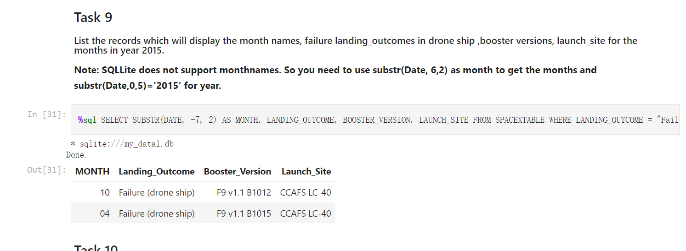
2015 Launch Records
Use ‘substr’ to get the value and use it to compare

Slide 33
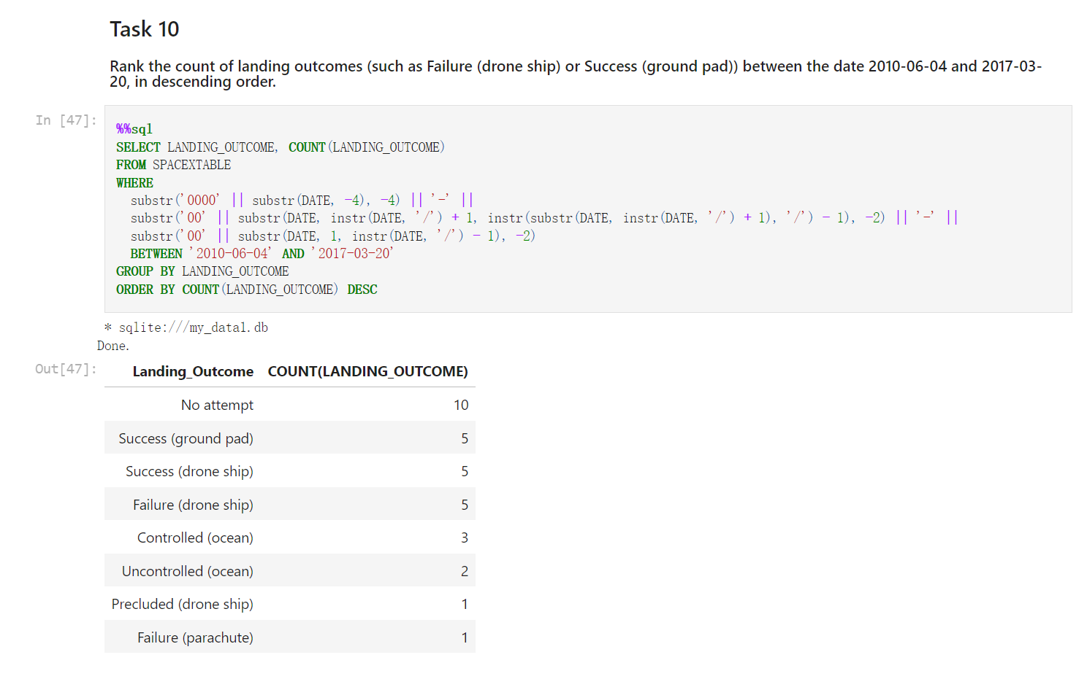
Rank Landing Outcomes Between 2010-06-04 and 2017-03-20
make the date format same first
filter out the date we want

Slide 34

Section 3

Slide 35
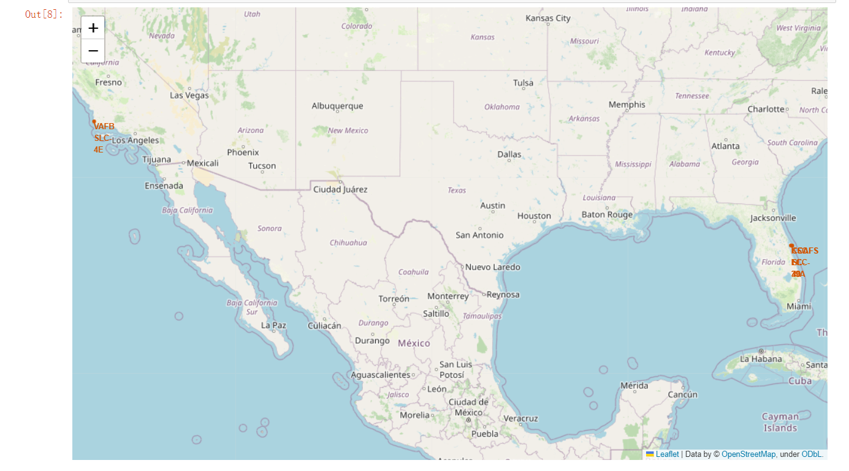
All launch sites’ location markers on a global map
All launch sites are near the ocean.

Slide 36
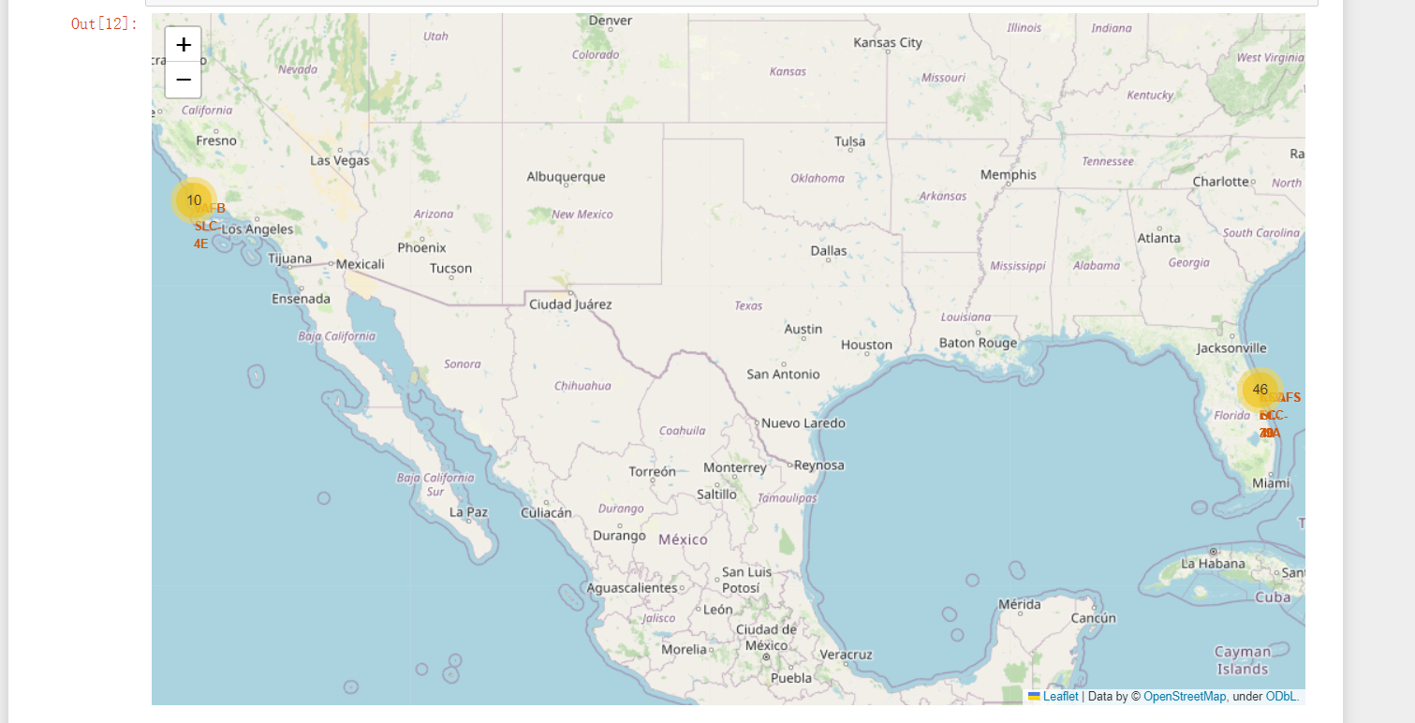
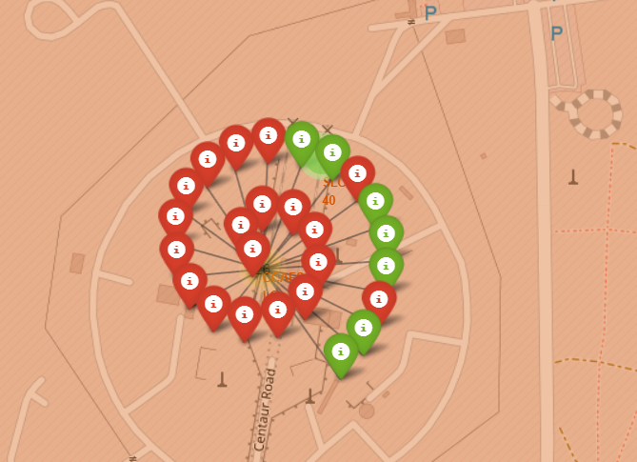
The color-labeled launch outcomes on the map
Replace <Folium map screenshot 2> title with an appropriate title
Explore the folium map and make a proper screenshot to show the color-labeled launch outcomes on the map
can see the number of flights in the location
can see the detail of the location by clicking it

Slide 37
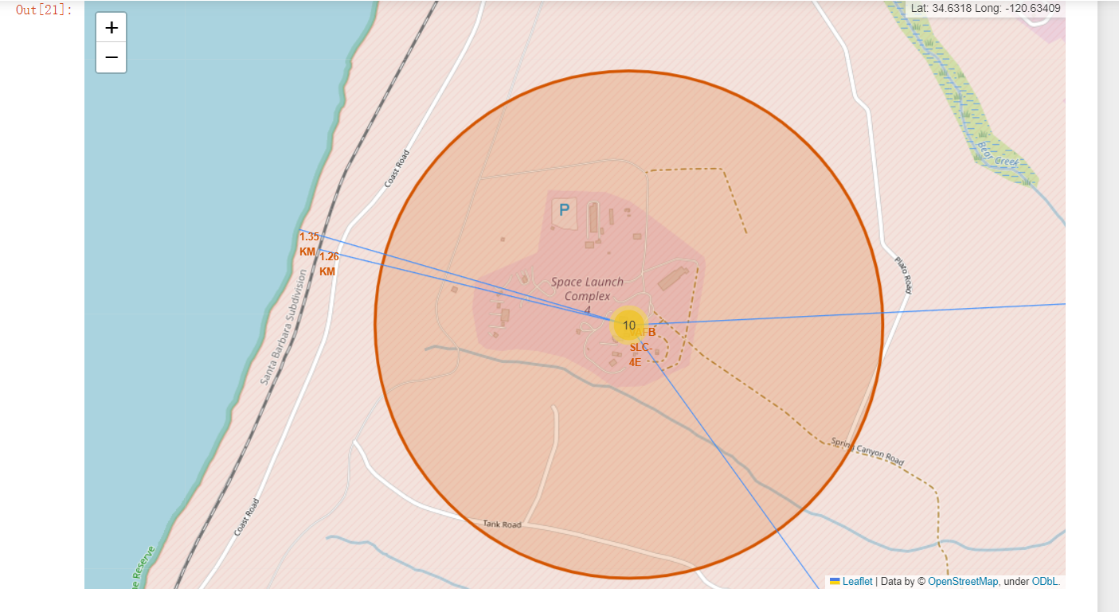
Launch site VAFB SLC-4E to its proximities
For VAFB SLC-4E, it is close to coastline and rail way, far away from city and highway.
Close to coastline can avoid too much damage when failure
Close to railway can improve the efficiency of transporting supply
Far from city and highway can minimize the damage to human

Slide 38

Section 4

Slide 39
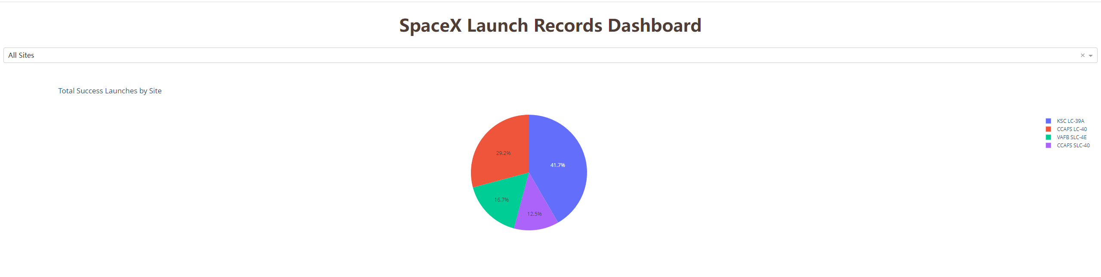
Launch success count for all sites
Replace <Dashboard screenshot 1> title with an appropriate title
Show the screenshot of launch success count for all sites, in a piechart
KSC LC-39A has the most success count and CCAFS SLC-40 has the least.

Slide 40
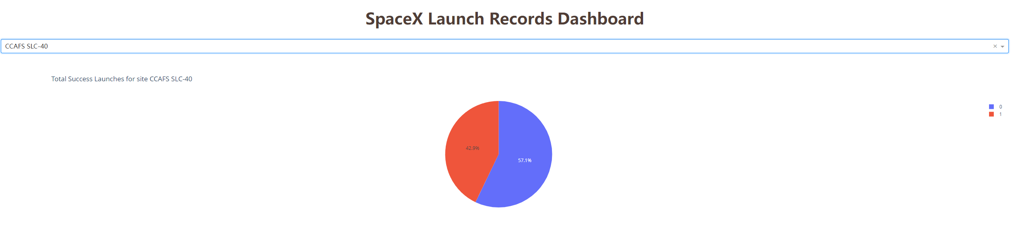
The launch site with highest launch success ratiothe launch site with highest launch success ratio
Replace <Dashboard screenshot 2> title with an appropriate title
Show the screenshot of the piechart for the launch site with highest launch success ratio
The launch site with highest launch success ratiothe launch site with highest launch success ratio is CCAFS SLC-40

Slide 41
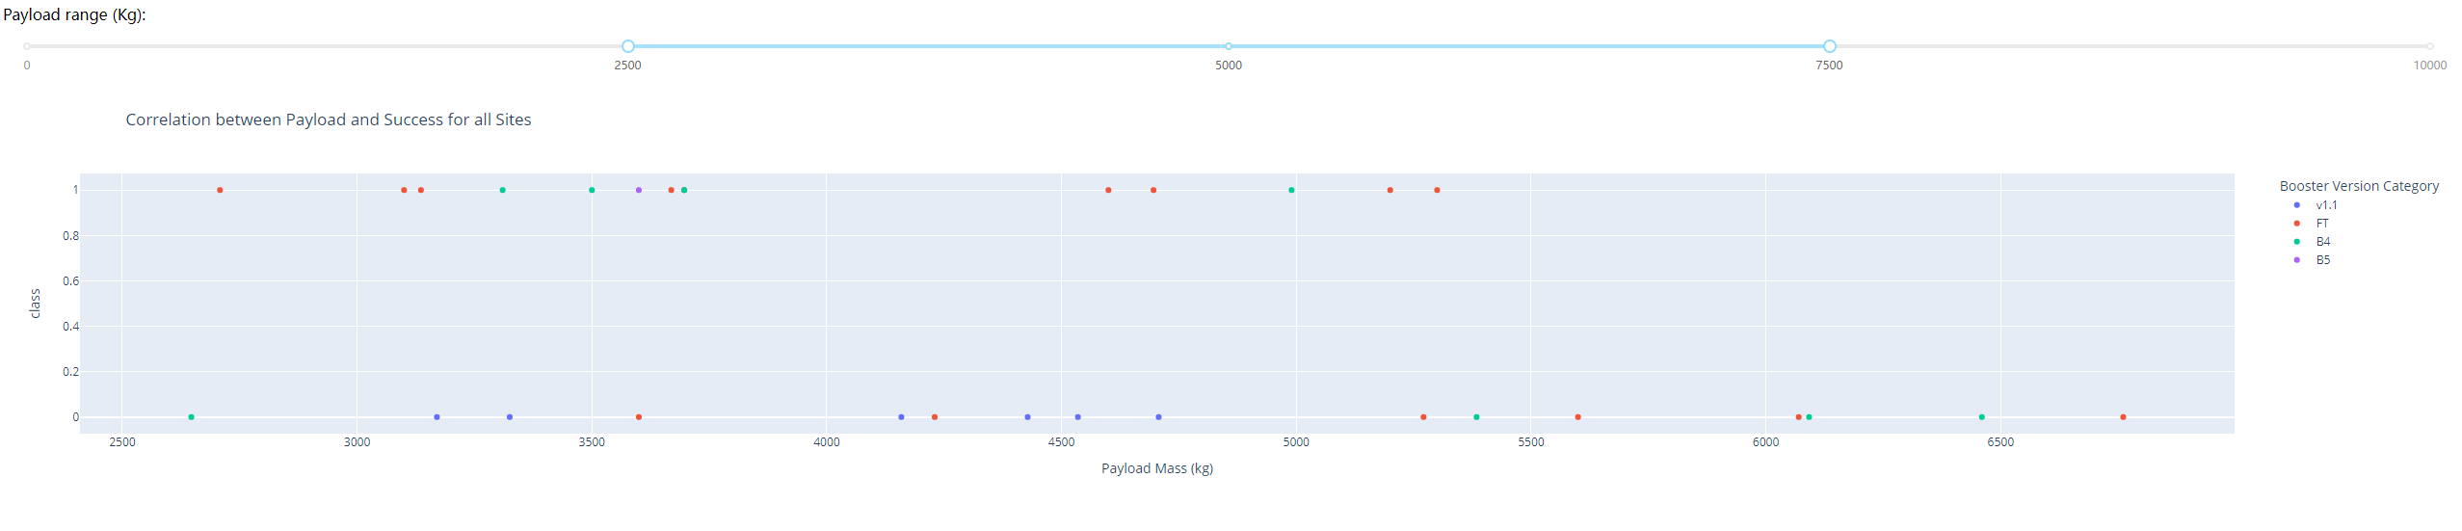
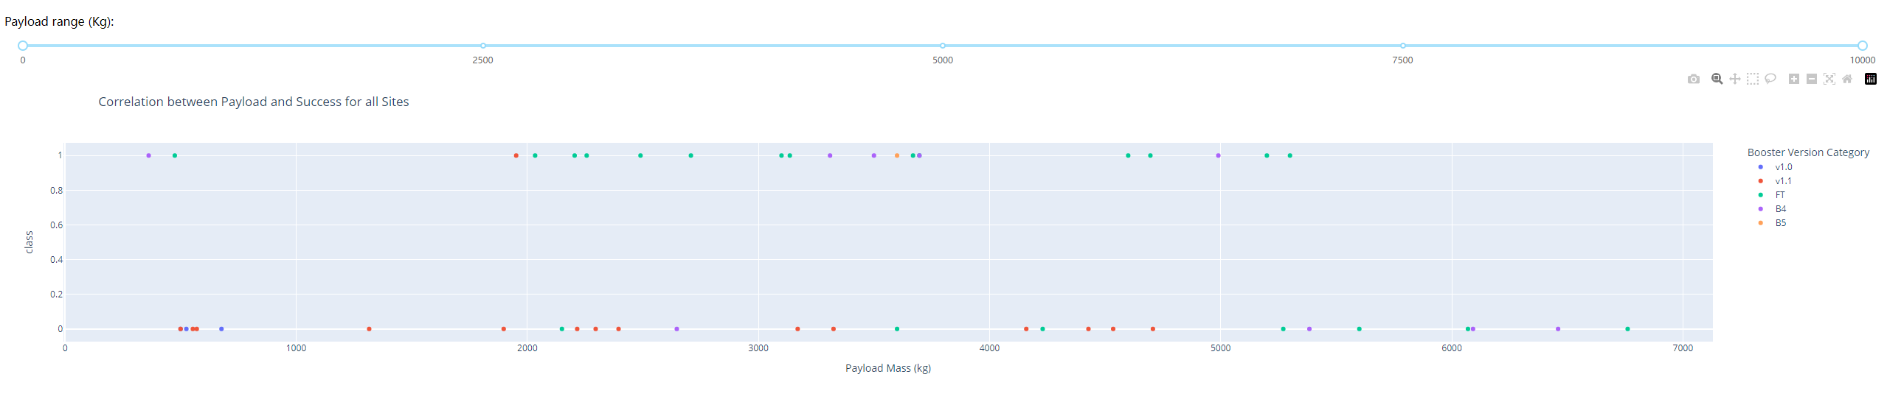
Payload vs. Launch Outcome scatter plot for all sites
Using this functionality can easily compare the success rate for different mass group

Slide 42

Section 5

Slide 43
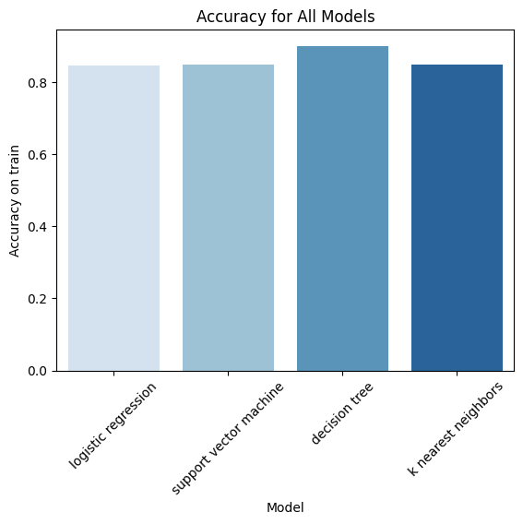
Classification Accuracy
The decision tree model has the best accuracy.

Slide 44

Confusion Matrix
In the confusion matrix, we can see only 2/18 cases are labeled incorrectly.

Slide 45
Conclusions
AS the number of flights increase, the success rate increases
There are some Orbit has 100% success rate with relatively small number of samples
KSC LC-39 has the most count of success flights
CCAFS SLC-40 has the highest success rate
Best model in this case is decision tree model

Slide 46
Appendix
Thank you for all the code templates and labs provided by IBM teaching team

Slide 47


